Slide 1
SAP Sync – An LLM Powered Integration Assistant
July 2024

Slide 2
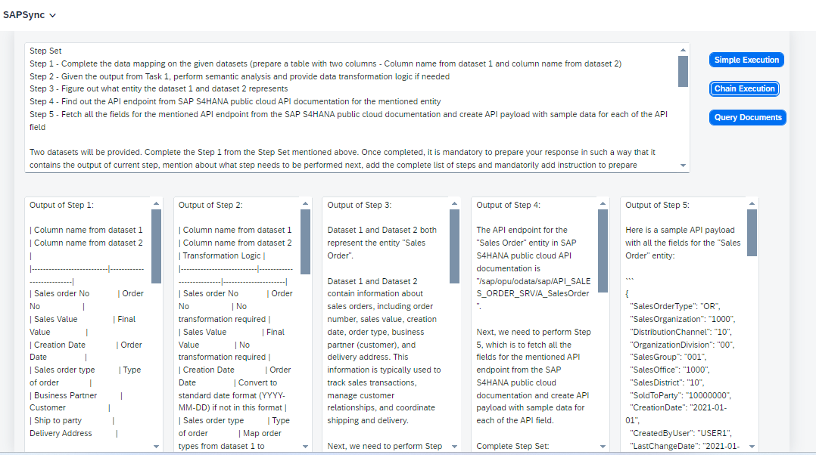
An LLM powered Integration Assistant
Ask any question related to integration between SAP and 3rd party application given the two datasets
Simple query and answer
Prompt template consisting of set of instructions to perform
Data mapping
Data transformation
API endpoint identification
Sample payload generation
Chain of prompts
Root cause analysis by querying over documents in Vector DB
FS and TS
KCDs
Software documentation, etc.
Give set of instructions and two datasets (SAP and 3rd party app) and choose among the three options.
Fusion RAG based query and answer

Slide 3






An LLM powered Integration Assistant
Key challenge solved
Applicable across all industries
CHALLENGE
RESULTS
Complex field mapping
Mapping logic for category variables and data transformation rules
RCA through use of software documentation / internet resources
Test data generation
70-80% effort reduction in field mapping and data transformation logic
SOLUTION
50-60% effort reduction in root cause analysis of integration errors
Chain of prompts to the LLM powered assistant for field mapping , data transformation and test data generation
Fusion RAG to query the software documentation, KCDs, etc.

